Slide 1
110
Carmen leon

Slide 2
History
Located in the northern part or queens, 110th precinct is commanded by Captain Nicola venter.
Two communities are found in 110th precinct; corona and Elmhurst communities
This is mainly a residential and commercial community. It has multiple homes and Lefrak city as the major apartment.
11oth precinct has three districts; broadways, queens Blvd, and Roosevelt avenue.

Slide 3
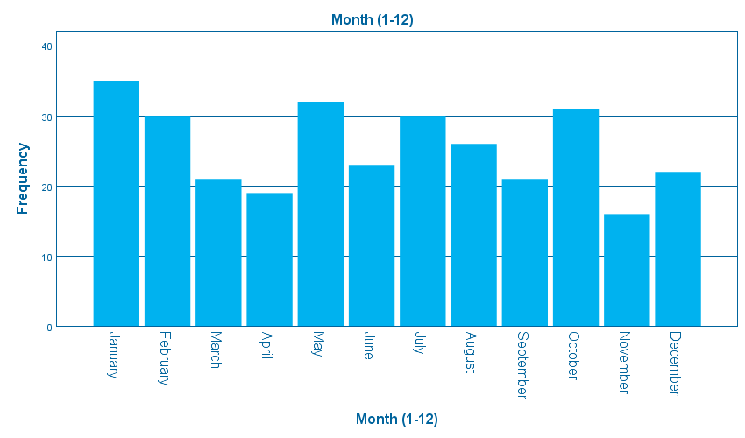
A bar chart showing precipitation against month

Slide 4
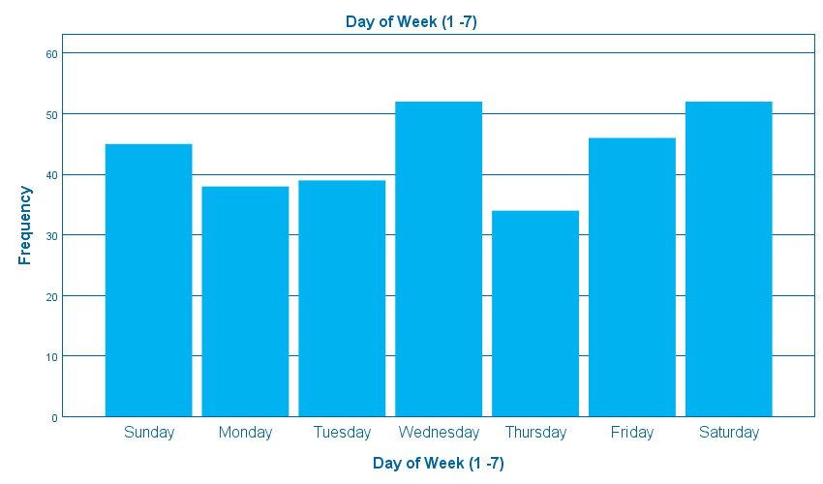
Bar chart showing temperature against day of the week

Slide 5
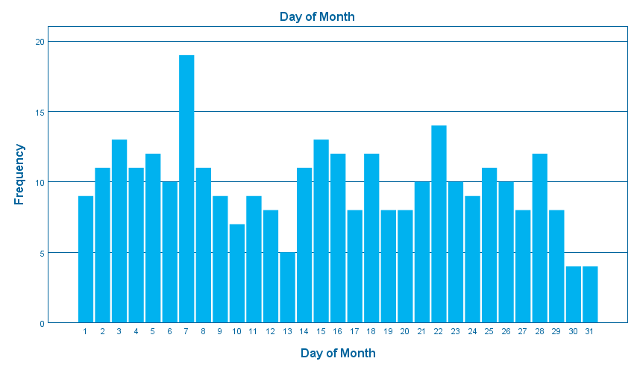
A bar chart showing premise ty against day of the month

Slide 6
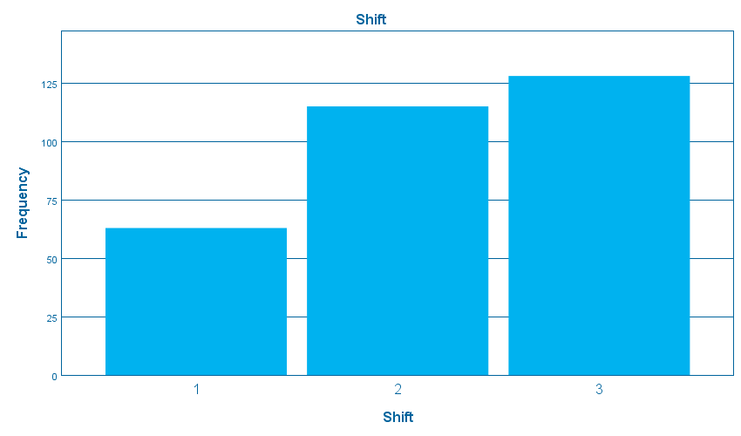
A bar chart showing location of occurrence against Shift

Slide 7
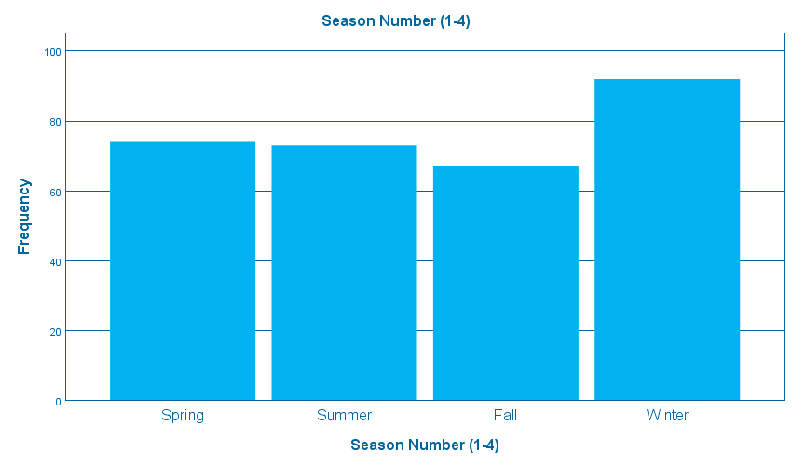
A bar chart showing police description against season number

Slide 8
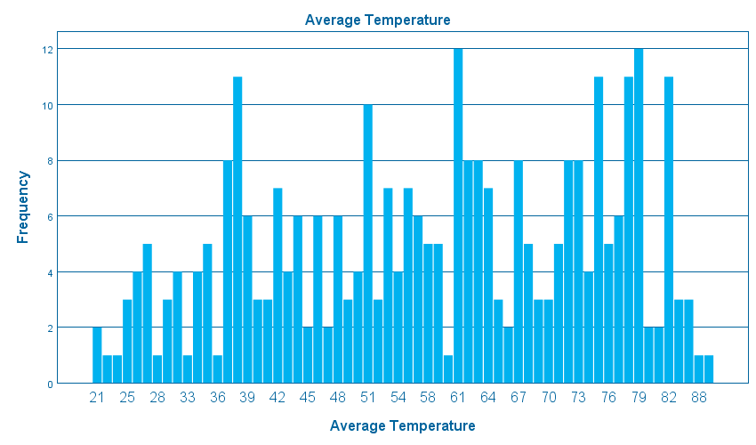
A bar chart showing day of the month against Average temperature

Slide 9
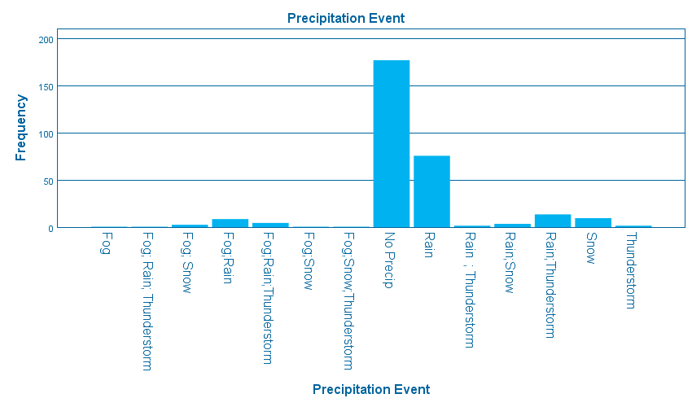
A bar chart showing month against Precipitation event

Slide 10
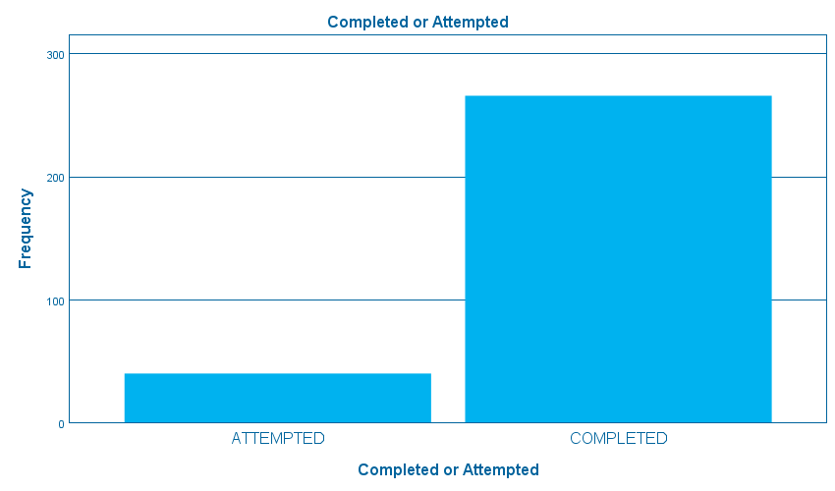
A bar chart showing police description Completed or attempted

Slide 11
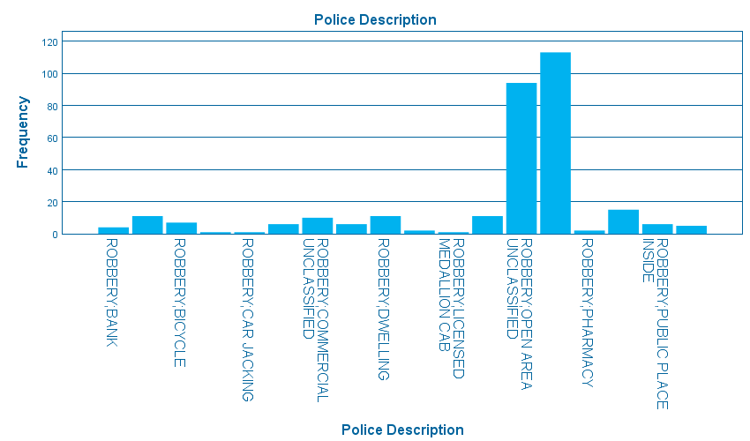
A bar chart showing against Police description

Slide 12
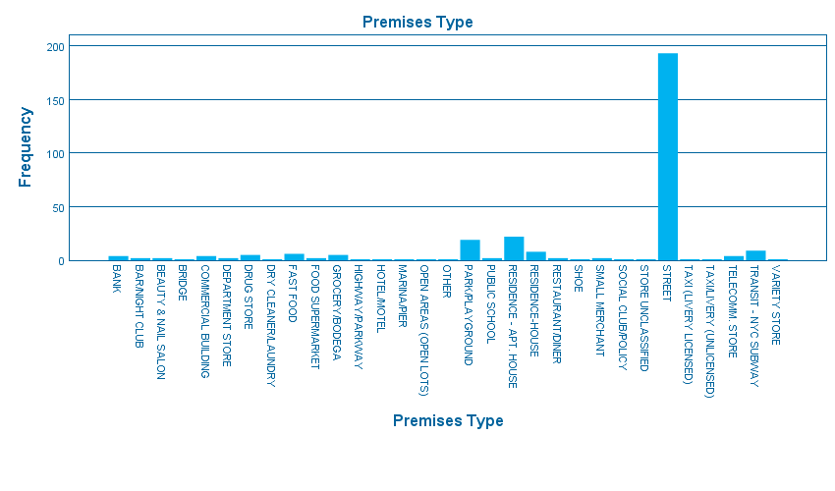
A bar chart showing police description against Premise type

Slide 13
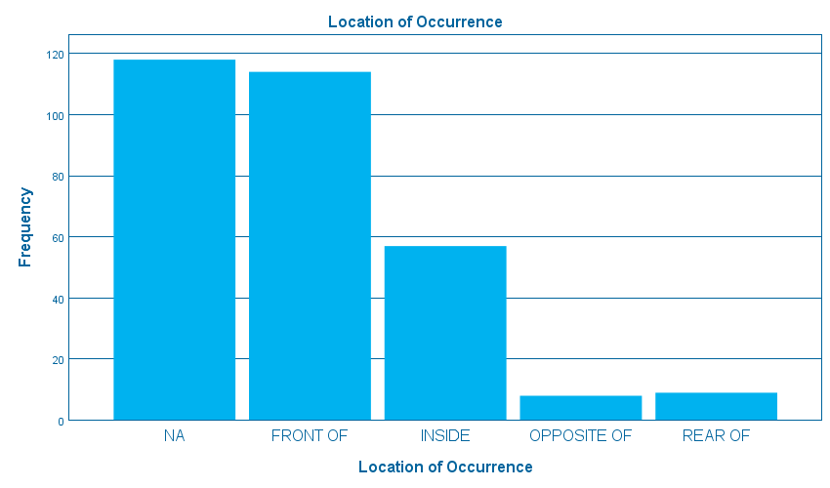
A bar chart showing shift against Location occurrence

Slide 14
What data does the variable represent, for example, day of the week, date, month, etc.?
Day of the week represents temperature
Day of the month represents premise type
Month represents precipitation
Shifts represents location of occurrence
Season number represents police description

Slide 15
What are the highest or peak values for the data shown?
Bar chart on month highest peak is 35 for January
Bar chart on Day of the week highest peak is 52 for Wednesday and Saturday
Bar chart day of the month highest peak is 19
Bar chart on shifts highest peak is 128
Bar chart on season highest peak is 92 for winter
Bar chart on average temperature is 11
Bar chart on precipitation event highest peak is 177 for no precipitation
Bar chat on completed / uncompleted highest peak is 266 for completed
Bar chart on police description highest peak is 113 for robbery for personal electronic devices
Bar chart on premises highest peak is 193 for street
Bar chart on location 118 for na

Slide 16
What are the lowest values for the data show?
Bar chart on month lowest value is 16
Bar chart on day of the week lowest value is 34 for Thursday
Bar chart on day of the month lowest value is 4 for day 30 and 31
Bar chart on shifts lowest value is 63
Bar chart seasons lowest value is 67 for fall
Bar chart on average temperature lowest value is 1
Bar chart on precipitation event lowest value is 1
Bar chart on completed/ uncompleted lowest value is 40 for uncompleted
Bar chart on police description lowest value is 1
Bar chart on premises lowest value is 1
Bar chart on location lowest value is 8

Slide 17
What do these highs and lowest say about robbery in your precinct?
The crime rate is very high in the precinct for robbery of personal electronics that has to be investigated more in order to establish the cause of the rise of these crimes.

Slide 18
How should these values affect robbery prevention strategies in your precinct?
The effect of this high crime rate is that more security personnel will be required to investigate the crimes.
Also, more properties of high value will be lost due to the robbery. This may come with more attacks on individuals

Slide 19
Think about each variable as you analyze it and come up with some of your own analysis questions to answer
Which month has the highest precipitation in precinct?
Which premise has the lowest attacks?
What is the average temperature when crime rates is high?
Which season is more prone to crime?
Which crime is committed more in the precinct?

Slide 20
What is the value highest precipitation in the precinct?
Rain with a frequency of 76

Slide 21
Which premise has the lowest crime attacks?
Highway/parking with 1 attack
Hotel/motel with 1 attack
Open areas with 1 attack
Shoe with 1 attack
Social club with 1 attack
Unclassified stores with 1 attack
Taxi/livery with 1 attack
Variety store with 1 attack

Slide 22
What is the average temperature when crimes crime rates are high?
61 with a frequency of 12
79 with a frequency of 12

Slide 23
Which crime is committed more in the precinct?
Robbery of personal electronic devices with a crime rate of 113 incidents

Slide 24
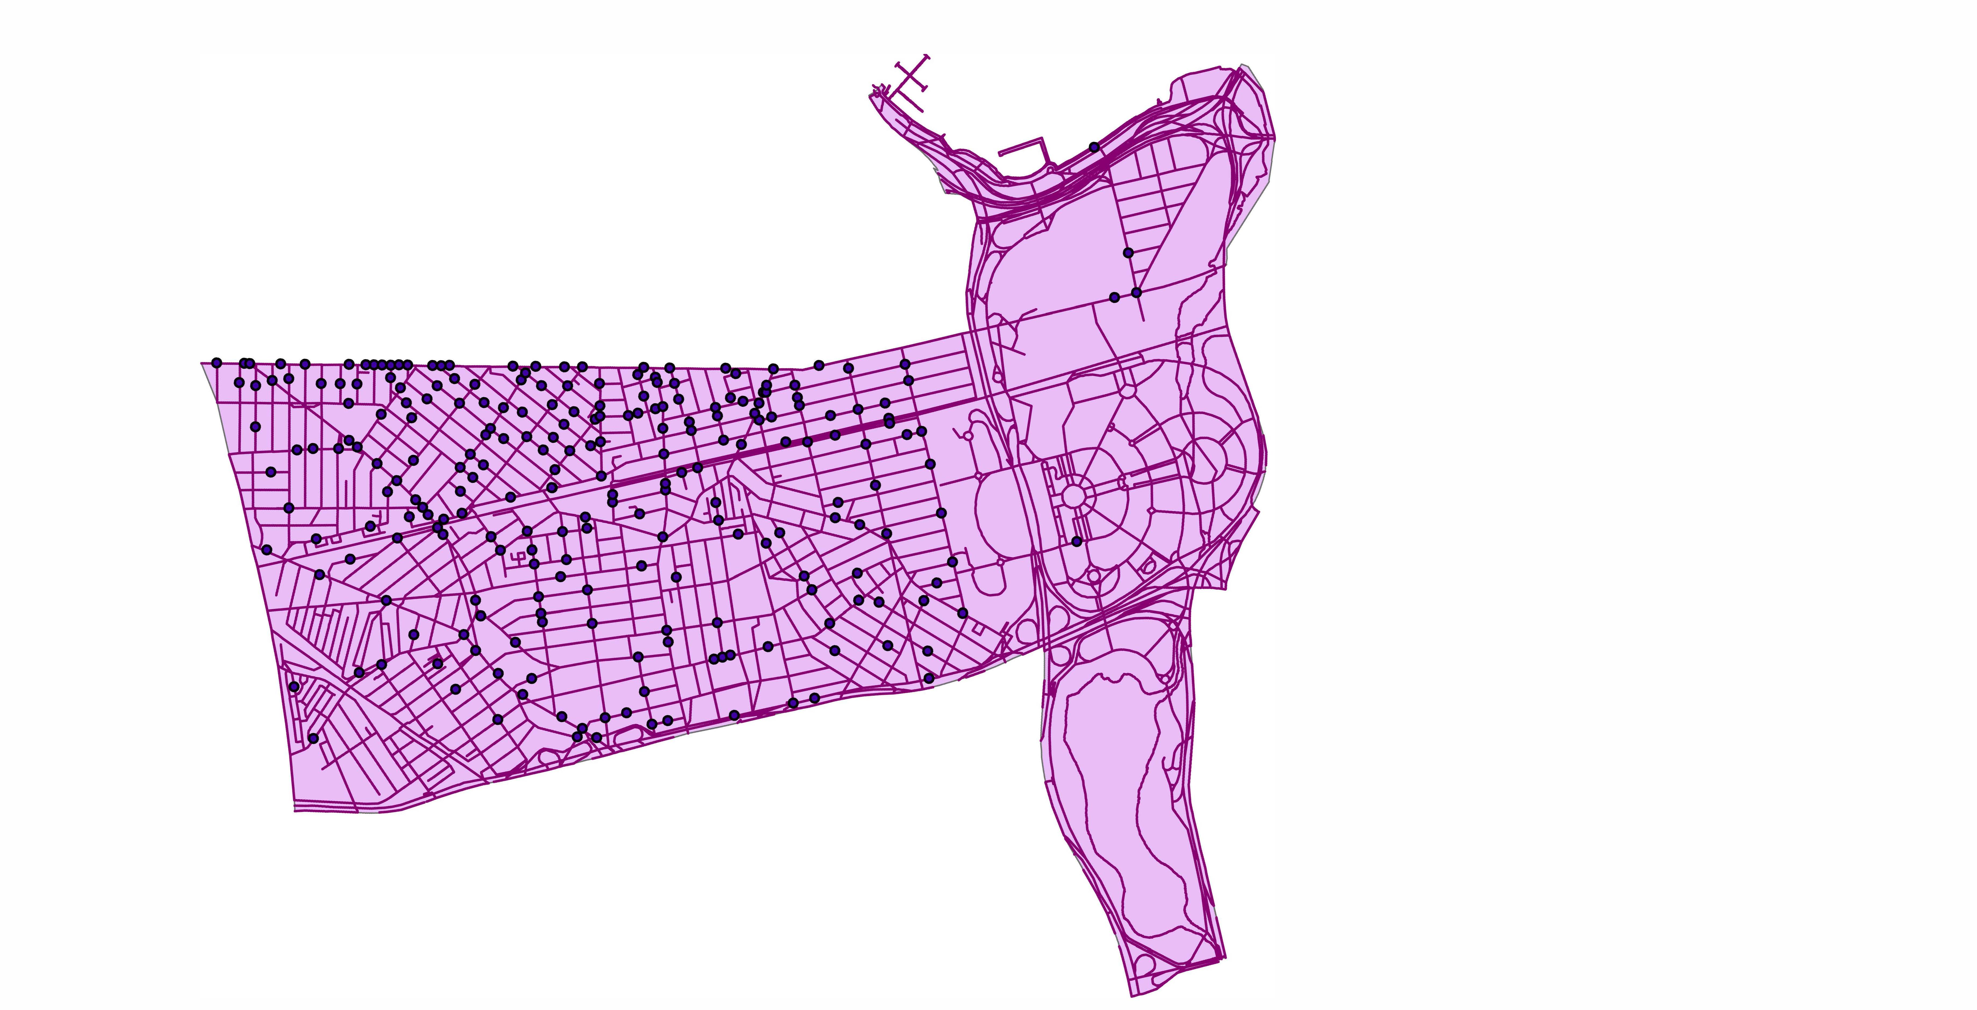

Slide 25
Does the data show clusters around a certain area in the precinct?
Yes . North west of the precinct has more data as compared to the others regions

Slide 26
Do any cluster relate to special attractions or circumstances in your precinct?
No.

Slide 27
Think about the map and come up with some of your own analysis questions to answer.
Which region has the highest number of clusters ?
Any region with no single cluster?

Slide 28
Which region has the highest number of clusters
North west region

Slide 29
Any region with no single cluster?
Yes. South eastern region

